Slide 1

Data Analytics Portfolio
Micky Smith
9/13/23

Slide 2
Table of Contents
Achievement 1: Game Co.
Global game sales analysis
Achievement 2: Influenza Season Preparation
Preparing for Influenza season in the United States
Achievement 3: Rockbuster
Creating a strategy for Rockbuster’s launch of an online movie service
Achievement 4: Instacart
Marketing strategies for an online grocery service
Achievement 5: Global Bank
Providing analytical support to Global Banks anti-money-laundering compliance department

Slide 3
1. Game Co. Project
Provide global gaming sales analysis

Slide 4
Game Co.
Project Goal
Perform a descriptive analysis of a global video game data set to provide understanding of how Game Co’s new games might fare in the market.
Data Set
VG Sales.clean
Tools
Microsoft Excel
Microsoft Powerpoint
Analytical Techniques
Grouping Data
Summarizing Data
Excel Visuals
Presenting Results

Slide 5
Game Co.
Stakeholder’s assumption was that region sales have remained constant over time
The graph provided shows that globally sales have gone down since 2012. European sales outsold North American sales for the first time in 2016. This graph provided a good understanding of where Game Co.’s focus should reside.
Further investigation showed that this data set provides physical sales, while later years digital sales were more predominate then physical sales.

Slide 6
Game Co.
Game Co.
VG Sales data set showed which genres sold best between each region. We found that Action games performed best in North America and Europe, while sport games were next. Role-playing games performed best in Japan, with action being second.
This graph provides insight into what games Game Co. should focus on pushing in which region.

Slide 7
Game Co.
Recommended Actions:
Focus on regional sales with favored genres in mind.
Look towards digital marketing of games, since physical copies are becoming less sought after with technology advancements.
Continue current marketing in North America, while expanding the market in Europe, and provide a heavy adjustment to the marketing in Japan.
Project Links:
Game Co. Powerpoint

Slide 8
2. Influenza Season Preparation
Help prepare for the coming years influenza season

Slide 9
Influenza Season Preparation
Project Goals
Preparing for flu season for the following year in the United States. Hospitals and clinics need additional staff to adequately treat more patients. The medical staffing agency provides this temporary staff.
Data Sets
CDC_Influenza_Deaths_edited
Dataset_For_Tableau
Finalized_Dataset
Tools Used
Microsoft Excel
Tableau
Analytical Techniques
Data cleaning, integration, and transforming
Translating business requirements
Statistical hypothesis
Visuals in Tableau
Presenting results to an audience

Slide 10
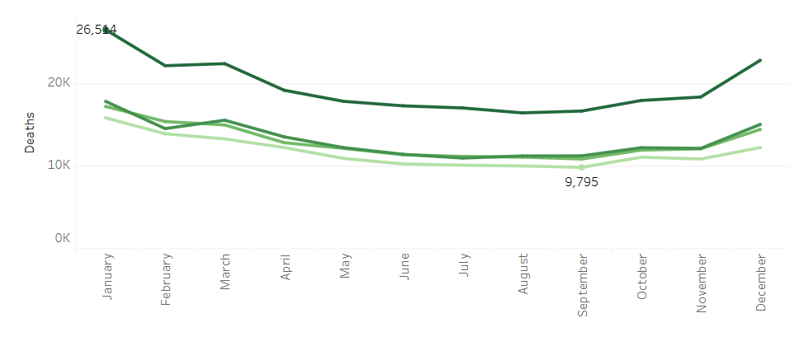
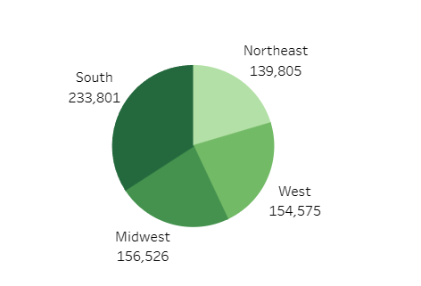
Inlfuenza Season Preparation
When is influenza season and what region is most affected?
Influenza season increased in October and begins to decline after April. With it’s peak in January.
The Southern region has the most influenza deaths, with the Midwest has the second largest impact.

Slide 11
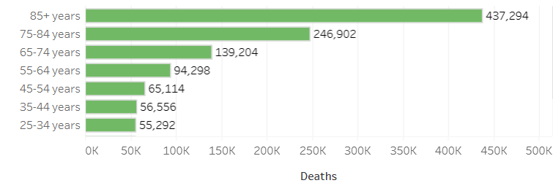
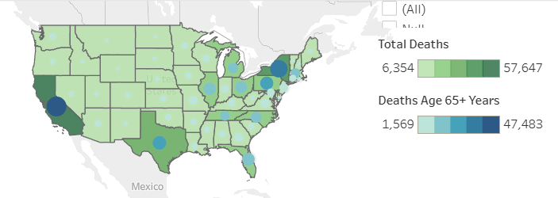
Influenza Season Preparation
Who is most vulnerable and where?
Most vulnerable population are those 65+ years old. They are at highest risk for hospitalization and death.
California, New York, Florida, Pennsylvania, and Texas have the highest average death rates for flu season.

Slide 12
Influenza Season Preparation
Recommended Actions:
Focus on placing more staff in areas with heavy population of people 65 and over.
More staffing would be needed between October to April.
California, New York, Texas, Pennsylvania, and Florida are the states that should have the most focus, then looking into medium priority states in the Southern region, then the Midwest.
Project Links:
Project Brief
Influenza Season's Final Project

Slide 13
3. Rockbuster Stealth
Create a strategy for Rockbuster Stealth’s launch of an online movie service

Slide 14
Rockbuster Stealth
Project Goals
Launch strategies for a new online video rental service.
Data Sets
Data Gathered From SQL
Rockbuster Stealth Data Dictionary
Tools Used
Microsoft Excel
Microsoft Powerpoint
Tableau
SQL
Analytical Techniques
Relational database
Database querying
Filtering
Cleaning and summarizing data in SQL
Subqueries
Joining tables
Common Table expressions

Slide 15
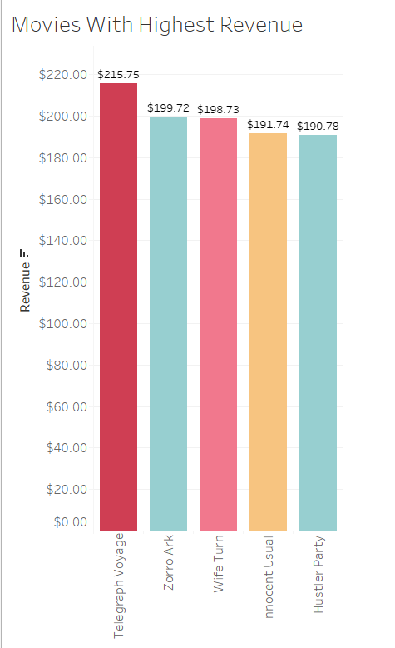
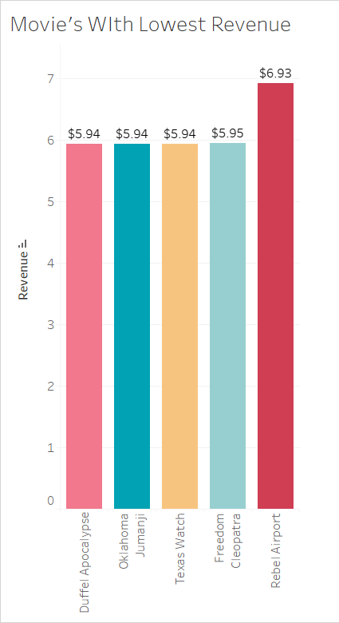
Rockbuster Stealth
By utilizing SQL queries, I was able to clean, summarize, and join tables to provide answers to questions provided and use Tableau to visualize those answers
What movies contributed the most/least revenue gain?

Slide 16
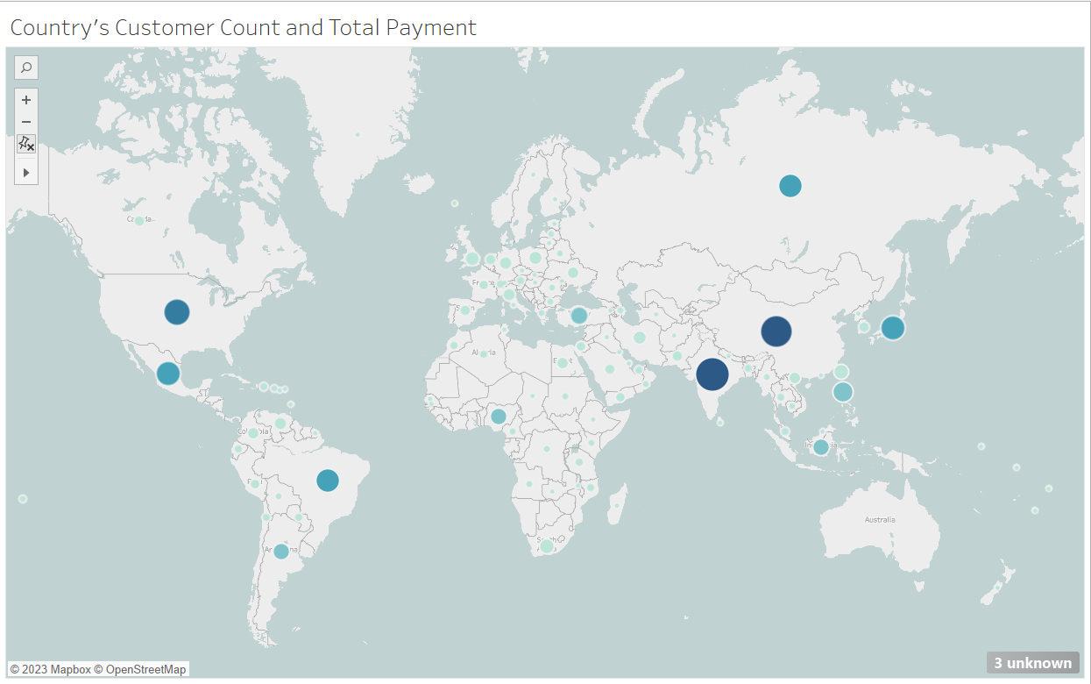
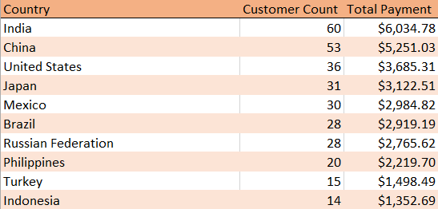
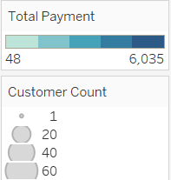
Rockbuster Stealth
What countries are rockbuster customers based in?
How do sales figures differ between geographical regions?

Slide 17
Rockbuster Stealth
Thanks to the questions answered from the data provided. Some recommendations were made towards the online movie release:
Content – Expand portfolio to other languages. Price movies based on popularity. And consider local movies produced in counties with high rental rates.
Marketing – Target countries with highest rental rates. Provide a loyalty program. And implement promotional offers and discounts to new customers.
Project Links:
Project Brief
Project Final Summary
Project Powerpoint

Slide 18
4. Instacart
Performed exploratory analysis to help company understand their sales patterns based on current sales and customer data.

Slide 19
Instacart
Project Goals
Use exploratory analysis strategies to derive insights and suggest strategies for better segmentation
Data Sets
Original Data
Scripts
Tools Used
Microsoft Excel
Python
Pandas
Jupyter
Analytical Techniques
Data wrangling and merging
Summarizing data
Deriving variables
Grouping & aggregating data
Visuals in Python

Slide 20
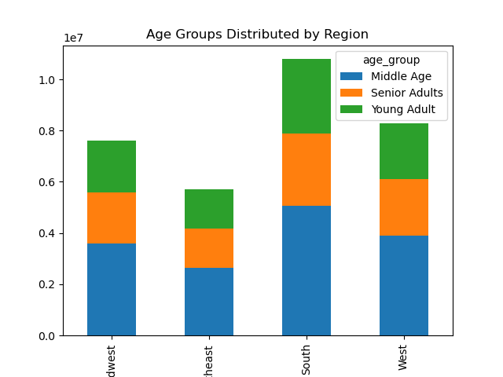
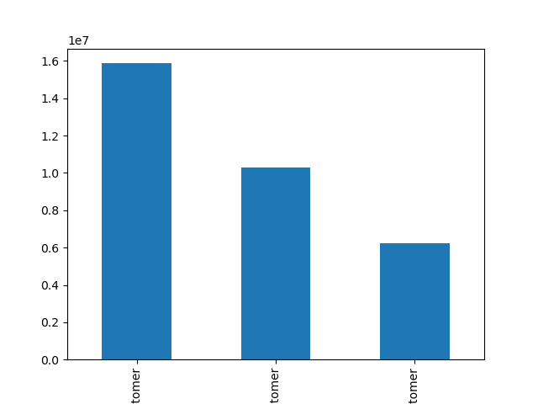
Instacart
From the graphs provided you can see the South consums more products from insacart. Next is the West, then Midwest and Northeast consumes the least.
Regular customer’s who purchased items every 10-20 days are the most popular type of customer. Next are loyal customers who order more than or equal to every 10 days. And new customers are represented in the remainder of the graph

Slide 21
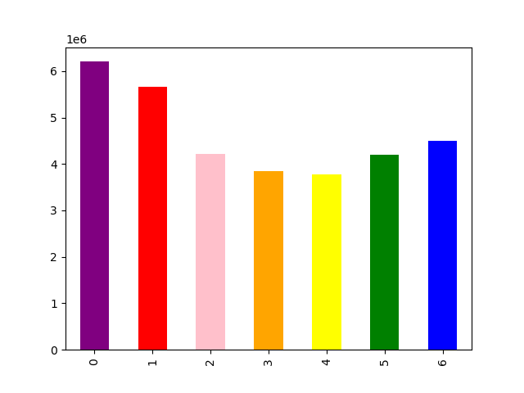
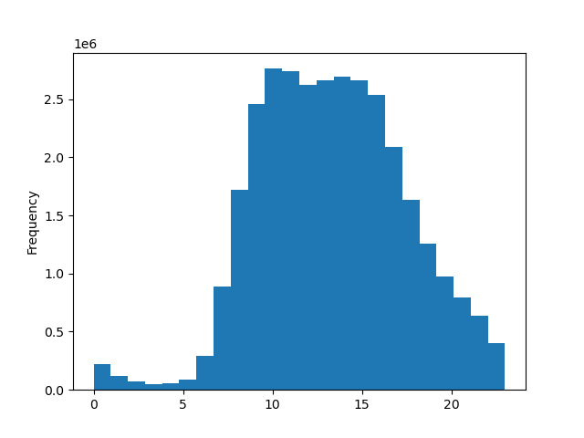
Instacart Project
Instacart
0 = Saturday
1 = Sunday
2 = Monday
3 = Tuesday
4 = Wednesday
5 = Thursday
6 = Friday
Saturday and Sunday are the busiest shopping days with Friday, Monday, Thursday, Tuesday, and Wednesday the least busy.
This histogram displays the hours of the day on the x-axis. Given that information, the hours between 9AM-2PM are when Instacart users are most likely to use the service.

Slide 22
Instacart
Recommendations:
Utilizing more eye-catching advertising during the week
Offer discounts and incentives during non-peak times
Introduce a loaylaty program with points to encourage regular customers and new customers to order more frequently.
Increase tailered advertisements in the Northeast and Midwest to increase customers in these regions.
Project Links:
Project Brief
Project Final Report

Slide 23
5. Global Bank
Providing analytical support to Global Banks anti-money-laundering compliance department

Slide 24
Global Bank
Project Goals
Help build and optimize models that assist the bank in running their compliance program more efficiently
Data Set
PigEBank-Client-Dataset-Cleaned
Tools Used
Microsoft Excel
Microsoft Powerpoint
Github
Analytical Techniques
Big data
Cleaning data
Data ethics, mining, and bias
Predictive analysis
Time series & forecasting
Github

Slide 25
Global Bank
The data set was cleaned using the following methods:
Removing row_number and Last_Name columns
Replaced “Blank” in Credit Score with N/A
In Country column changed abbreviated ES, FR, and DE to Spain, France, and Germany
In Gender column changed F and M to Female/Male. Replaced NULL with N/A
In Age column changed 2 and NULL to N/A
In Estimated Salary column changed Blank and NULL values to N/A

Slide 26
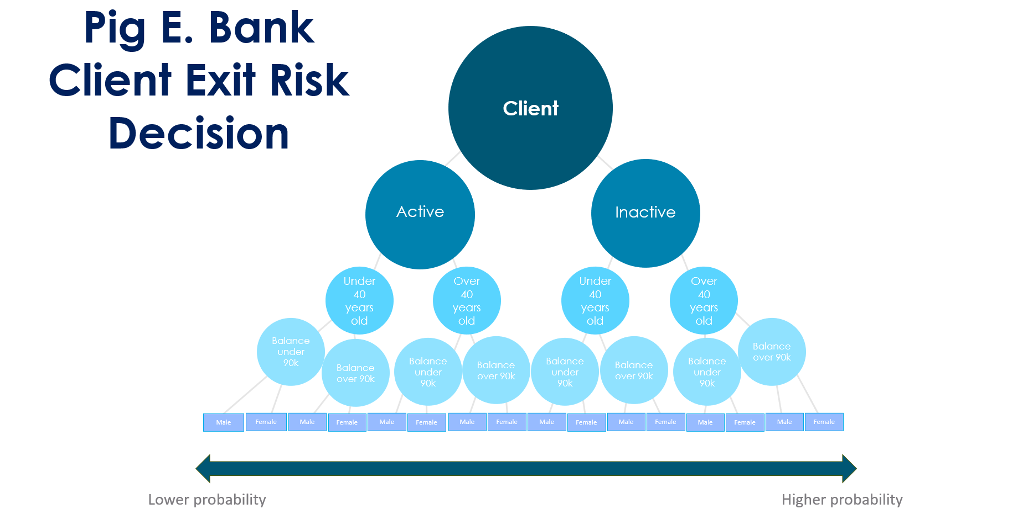
Global Bank
Then created this graph to provide an understanding towards whether a customer would leave or stay a member of the bank.

Slide 27
Global Bank
Project Links:
Project Brief
Project Files

Slide 28
Achievement 6

Slide 29
Achievement 6

Slide 30
Achievement 6

Slide 31
Achievement 6

